Slide 1

Mathematics of Data I Geometric Data Analysis – From PCA/MDS to ISOMAP/LLE
姚 远
北京大学数学科学学院
2011.7.11

Slide 2
Data Science is the science of Learning from Data. In mathematics, we look for mappings from data domain to knowledge domain.

Slide 3
John Dewey
If knowledge comes from the impressions made upon us by natural objects, it is impossible to procure knowledge without the use of objects which impress the mind.
Democracy and Education: an introduction to the philosophy of education, 1916

Slide 4
Statistics has been the most successful information science. Those who ignore Statistics are condemned to reinvent it. ---- Bradley Efron

Slide 5
Types of Data
Data as vectors/matrices/tensors in Euclidean spaces
images, videos, speech waves, gene expr., financial data
most of statistical methods deal with this type of data
Data as graphs
data as points in metric spaces (molecular dynamics, etc.)
internet, biological/social networks
data where we just know relations (similarity,…)
data visualization
modern Computer Science likes this type of data
and there are more coming …

Slide 6
A Dictionary between Machine Learning vs. Statistics
Machine Learning | Statistics
Supervised Learning | Regression Classification Ranking …
Unsupervised Learning | Dimensionality Reduction Clustering Density estimation …
Semi-supervised Learning | ✗

Slide 7
Contributions
Machine learning and computer science society had proposed many of scalable algorithms to deal with massive data sets
Those algorithms are often found following consistency theory of statistics
But sometimes traditional statistics does not work …

Slide 8
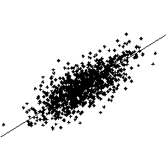
Principal Component Analysis (PCA)
Principal Component Analysis (PCA)
Eigen-decomposition of
for fixed p and n->∞
One Dimensional Manifold

Slide 9
PCA may go wrong if p ≥ n
For p/n = γ >0, assume p-dimensional X_{i}
where θ_{ν} are orthonormal, then PCA is inconsistent by Random Matrix Theory
Phase transition:
Below the threshold, estimation is orthogonal to the truth
Above the threshold, the angle decreases as eigenvalue grows, but always biased
Johnstone (2006) High Dimensional Statistical Inference and Random Matrices,
arxiv.org/abs/math/0611589v1

Slide 10

A Dawn of the Science for High Dimensional Massive Data Sets
When p>>n, PCA may work with additional requirements
Σ is sparse or fast decay
Σ⁻¹ is sparse
… (e.g. see Tony Cai tutorials)
Geometry and topology begin to enter this Odyssey
data concentrate on low-dimensional manifolds …

Slide 11
Geometric and Topological Methods
Algebraic geometry for graphical models
Bernd Sturmfels (UC Berkeley)
Mathias Drton (U Chicago)
Differential geometry for graphical models
Shun-ichi Amari (RIKEN, Japan)
John Lafferty (CMU)
Integral geometry for statistical signal analysis
Jonathan Taylor (Stanford)
Rob Ghrist (UIUC - U Penn)
Spectral kernel embedding:
LLE (Roweis, Saul etal), ISOMAP (Tennenbaum etal), Laplacian eigenmap (Niyogi, Belkin etal), Hessian LLE (Donoho etal), Diffusion map (Coifman, Singer etal)
Computational topology for data analysis
Herbert Edelsbrunner (Duke - Institute of Sci. Tech. Austria), Gunnar Carlsson (Stanford), et al.

Slide 12
Two aspects in those works
Geometry and topology may play a role as
characterizing local or global constraints (symmetry) in model spaces or data
algebraic and differential geometry for graphical models
spectral analysis for discrete groups (Risi Kondor)
characterizing nonlinear distribution (sparsity) of data
spectral kernel embedding (nonlinear dimensionality reduction)
integral geometry for signal analysis
computational topology for data analysis
Let’s focus on the second aspect.

Slide 13
Geometric and Topological Data Analysis
General area of geometric data analysis attempts to give insight into data by imposing a geometry (metric) on it
manifold learning: global coordinate preserving local structure
metric learning: find a metric accounting for similarity
Topological method is to study invariants under metric distortion
clustering as connected components
loops, holes
Between them, lies in Hodge Theory, a bridge over geometry and topology
0-dimensional Hodge Theory: Laplacian eigenmaps, Diffusion Maps
1-dimensional Hodge Theory: Preference Aggregation, Game Theory

Slide 14
What we’ll cover in this course?
I. Geometric Data Analysis: from PCA/MDS to LLE/ISOMAP
II. Geometric Data Analysis: diffusion geometry
III. Topological Data Analysis
IV. Hodge Theory in Data Analysis
V. Seminar

Slide 15
Manifold learning: Spectral Kernel Embeddings
Principle Component Analysis (PCA)
Multi-Dimensional Scaling (MDS)
Locally Linear Embedding (LLE)
Isometric map (ISOMAP)
Laplacian Eigenmaps
Diffusion map
Local Tangent Space Alignment (LTSA)
…

Slide 16
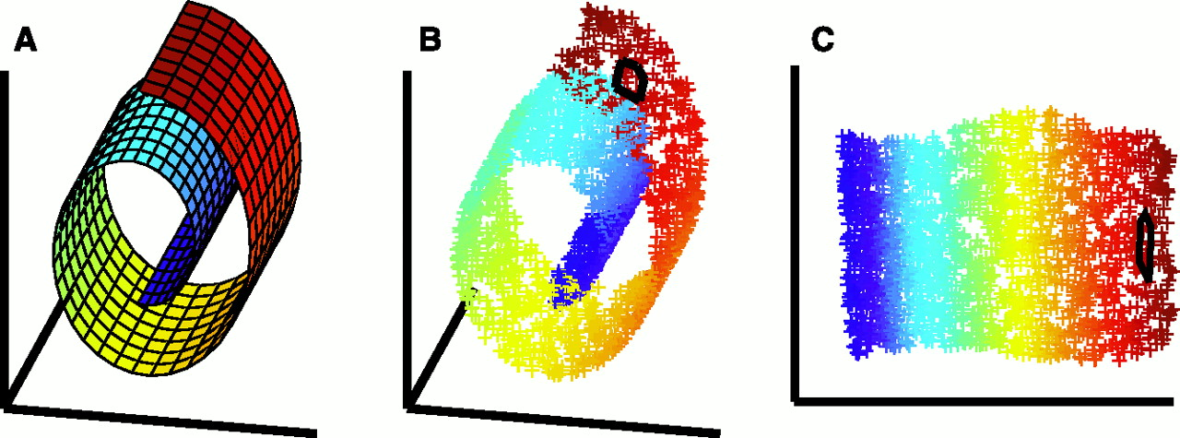
Dimensionality Reduction
Data are concentrated around low dimensional Manifolds
Linear：MDS, PCA
NonLinear: ISOMAP, LLE, …

Slide 17
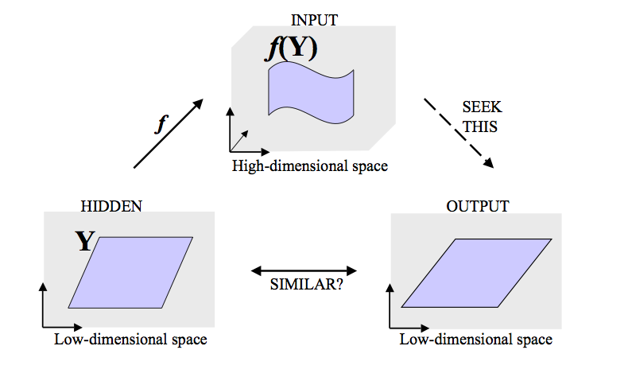
Generative Models in Manifold Learning

Slide 18
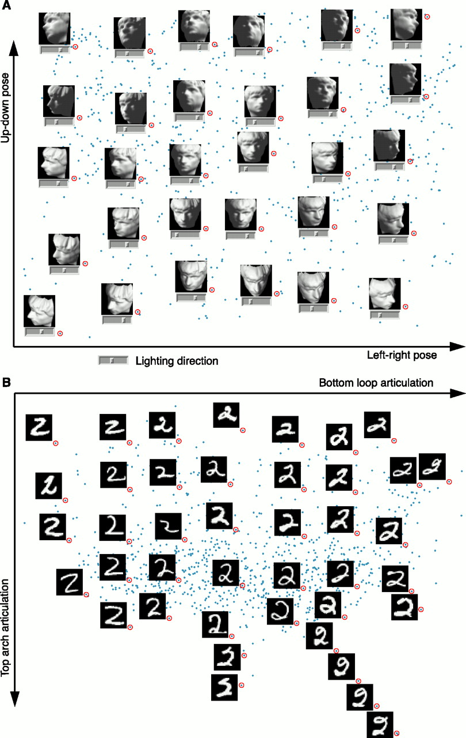
Example…

Slide 20
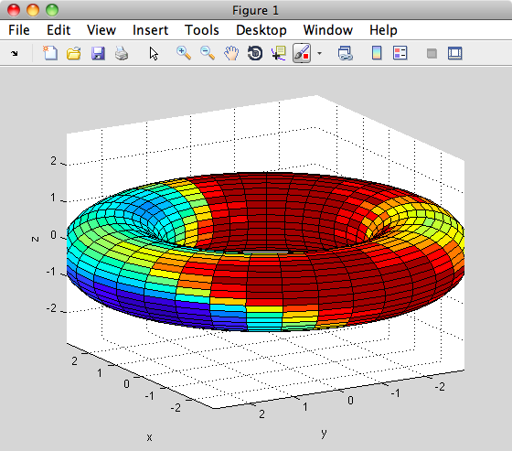
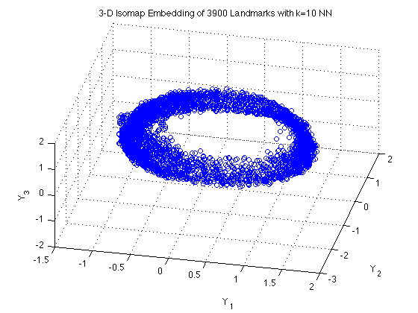
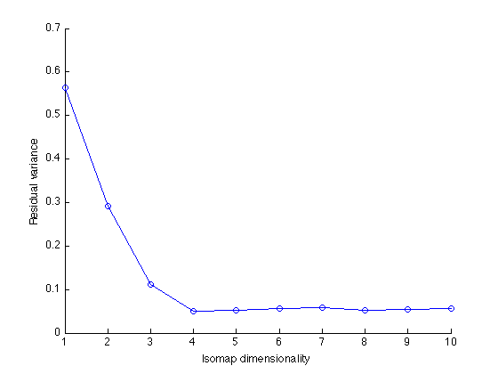
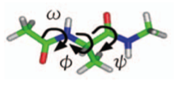
Biomolecular: Alanine-dipeptide
ISOMAP 3D embedding with RMSD metric on 3900 Kcenters

Slide 21
Distances & Mappings
Given an Euclidean embedding, it’s easy to calculate the distances between the points :
Multi-Dimensional Scaling (MDS) operates the other way round:
Given the “distances” [data] find the embedding map [configuration] which generated them
MDS can do so when all but ordinal information has been jettisoned (fruit of the “non-metric revolution”)
even when there are missing data and in the presence of considerable “noise”/error (MDS is robust).

Slide 22
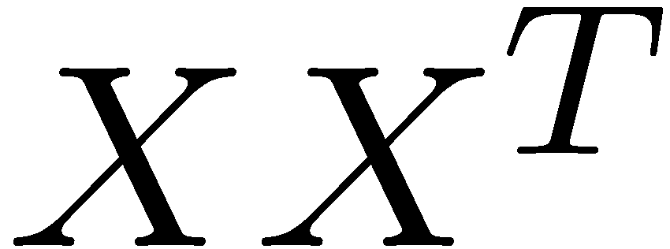
PCA => MDS
Here we are given pairwise distances instead of the actual data points.
First convert the pairwise distance matrix into the dot product matrix
After that same as PCA.
If we preserve the pairwise distances do we preserve the structure??

Slide 23
Matlab Commands
STATS toolbox provides the following:
cmdscale - classical MDS
mdscale – nonmetric MDS

Slide 24
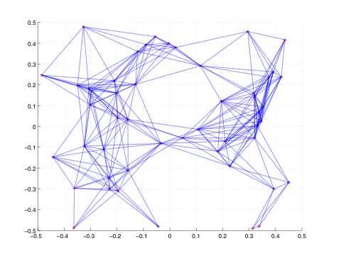
Example I: 50-node 2-D Sensor Network Localiztion

Slide 25
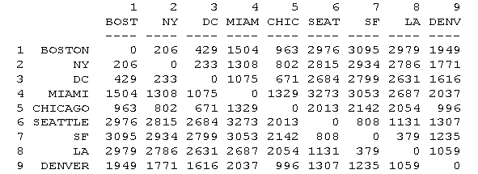
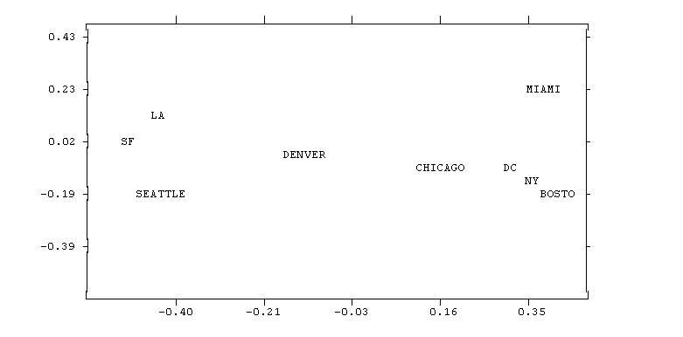
Example II City Map

Slide 26
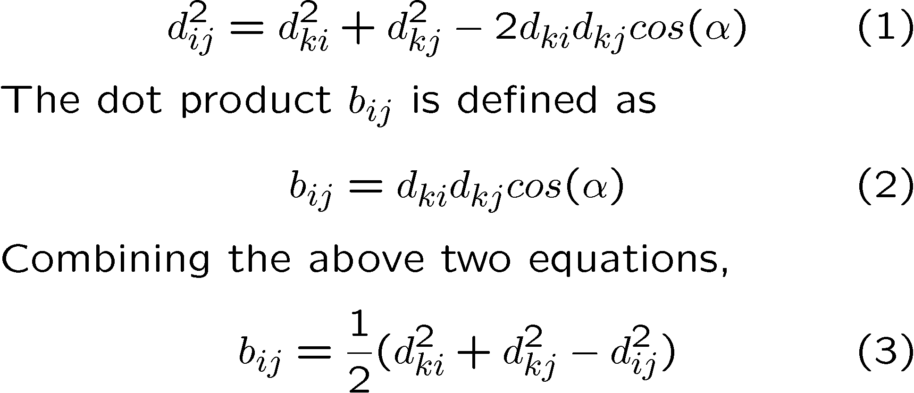
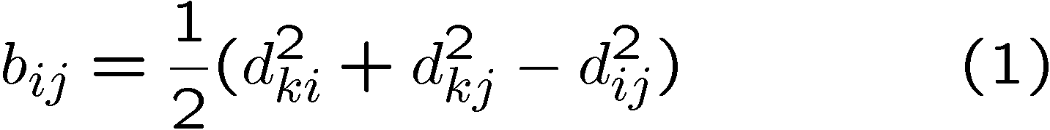
How to get dot product matrix from pairwise distance matrix?
i
k
j

Slide 27
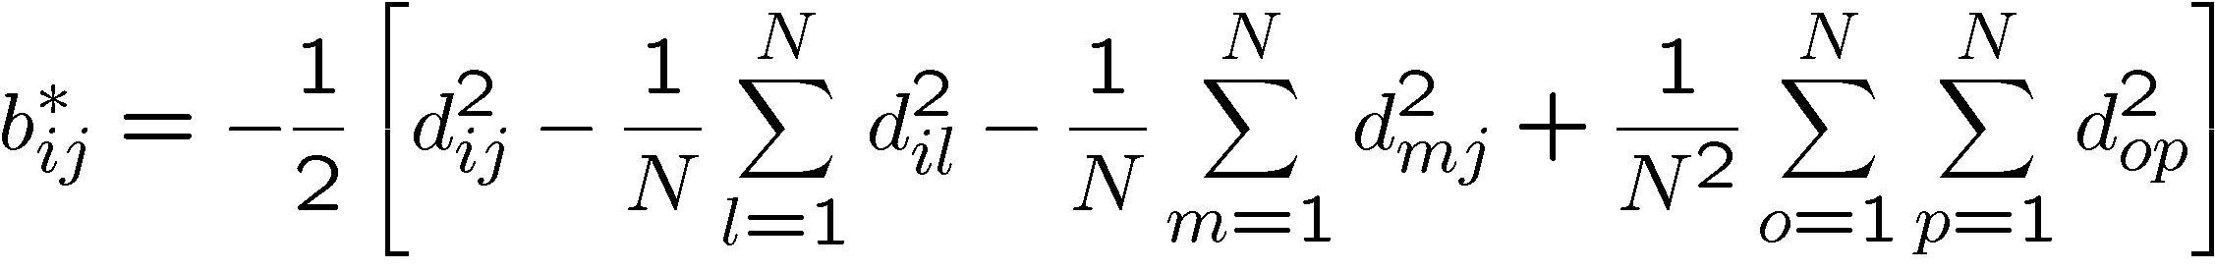
Origin centered MDS
MDS—origin as one of the points and orientation arbitrary.
Centroid as origin

Slide 28
MDS Summary
Given pairwise distances D, where D_{ij} = d_{ij}², the squared distance between point i and j
Convert the pairwise distance matrix D (c.n.d.) into the dot product matrix B (p.s.d.)
B_{ij} (a) = -.5 H(a) D H’(a), Hölder matrix H(a) = I-1a’;
a = 1_{k}: B_{ij} = -.5 (D_{ij} - D_{ik} – D_{jk})
a = 1/n:
Eigendecomposition of B = YY^{T}
If we preserve the pairwise Euclidean distances do we preserve the structure??

Slide 29
Theory of Classical MDS: a few concepts
An n-by-n matrix C is positive semi-definite (psd) if for all v∈R^{n}, v’Cv ≥ 0.
An n-by-n matrix C is conditionally negative deﬁnite (c.n.d) if for all v∈R^{n} such that sum_{i} v_{i}=0, v’Cv ≤ 0.

Slide 30
Young-Householder-Shoenberg Lemma
Let x be a signed distribution, i.e. x obeying sum_{i} x_{i}=1 while x_{i} can be negative
Householder centering matrix: H(x) = I – 1x’;
Define B(x) = - 1/2 H(x) C H’(x), for any C
Theorem [Young/Householder, Schoenberg 1938b] For any signed distribution x,
B(x) p.s.d. iff C c.n.d.

Slide 31
Proof
“⇐” first observe that if B(x) is p.s.d., then B(y) is also p.s.d. for any other signed distribution y, in view of the identity B(y) = H(y)B(x)H’(y), itself a consequence of H(y) = H(y)H(x). Also, for any z, z’B(x)z = −y’Cy/2, where the vector y = H’(x)z obeys sum_{i} y_{i} = 0 for any z, showing necessity.
“⇒” Also, y = H’(x)y whenever sum_{i} y_{i} = 0, and hence y’B(x)y = −y’Cy/2, thus demonstrating sufficiency.

Slide 32
Classical MDS Theorem
Let D be n-by-n symmetric matrix. Define a zero diagonal matrix C to be C_{ij} = D_{ij} – 0.5 D_{ii} – 0.5 D_{jj}. Then we have
B(x) := -0.5 H(x) D H’(x) = -0.5 H(x) C H’(x)
C_{ij} = B_{ii}(x) + B_{jj}(x) – 2B_{ij}(x)
D is c.n.d. iff C is c.n.d.
If C is c.n.d., then C is isometrically embeddable, i.e. C_{ij} = sum_{k}(Y_{ik}- Y_{jk})² where
Y= U Λ^{1/2}, with eigendecomp B(x) =U Λ U’

Slide 33
Proof
the first identity in follows from H(x)1 = 0;
the second one from B_{ii}(x) + B_{jj}(x) − 2B_{ij}(x) = C_{ij} − 0.5C_{ii} − 0.5C_{jj}, itself a consequence of the definition B_{ij}(x) = −0.5C_{ij} + γ_{i} + γ_{j} for some vector γ;
the next assertion follows from u’Du = u’Cu whenever sum_{i} u_{i} = 0;
the last one can be shown to amount to the second identity by direct substitution.

Slide 34
Remarks
P.S.D. B(x) (or c.n.d. C) defines a unique squared Euclidean distance D, which satisfies:
B_{ij}(x) = - 0.5 (D_{ij} – D_{ik} – D_{jk}), with freedom x to choose center
B = Y Y’, the scalar product matrix of n-by-d Euclidean coordinate matrix Y

Slide 35
Gaussian Kernels
Theorem. Let D_{ij} be a squared Euclidean distance. Then for any λ≥0, B_{ij}(λ)=exp(-λD_{ij}) is p.s.d., and C_{ij}(λ) = 1 – exp(-λ D_{ij}) is a squared Euclidean distance (c.n.d. with zero diagonal).
So Gaussian kernels are p.s.d. and 1 – gaussian kernel is a squared Euclidean distance.

Slide 36
Schoenberg Transform
A Schoenberg transformation is a function φ(D) from R+ to R+ of the form (Schoenberg 1938a)
where g(λ)dλ is a non-negative measure on [0, ∞) such that

Slide 37
Schoenberg Theorem [1938a]
Let D be a n x n matrix of squared Euclidean distances. Define the components of the n x n matrix C_{ij} as C_{ij} = φ(Dij). Then C is a squared Euclidean distance iff φ is the Schoenberg Transformation,

Slide 38
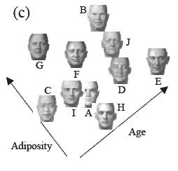
Extension I: Nonmetric MDS
Instead of pairwise distances we can use paiwise “dissimilarities”.
When the distances are Euclidean MDS is equivalent to PCA.
Eg. Face recognition, wine tasting
Can get the significant cognitive dimensions.

Slide 39
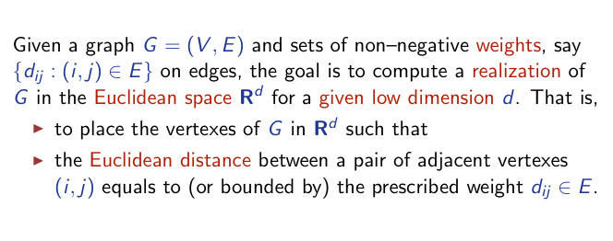
Extension II: MDS with missing values (Graph Realization Problem)
Classical MDS (complete graph with squared distance d_{ij}):
Young/Householder 1938, Shoenberg 1938

Slide 40
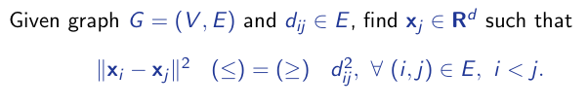
MDS with Uncertainty Quadratic equality and inequality system

Slide 41
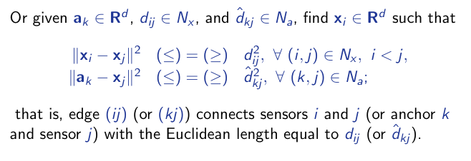
MDS in Sensor Network Localization: anchor points

Slide 42
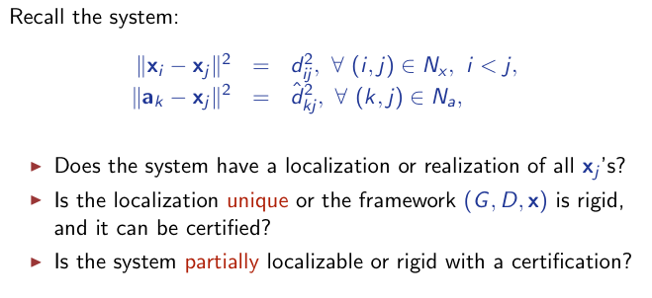
Key Problems

Slide 43
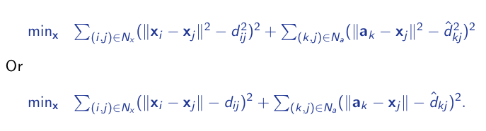
Nonlinear Least Squares
A difficult global optimization problem.

Slide 44
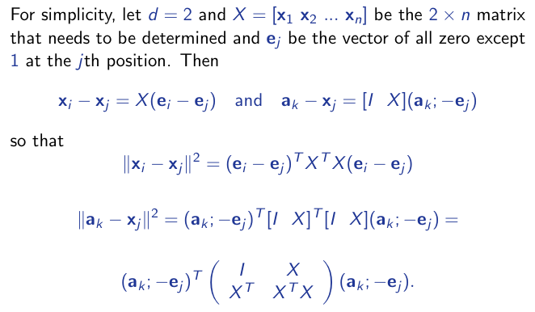
Matrix Represenation I
A difficult global optimization problem.

Slide 45
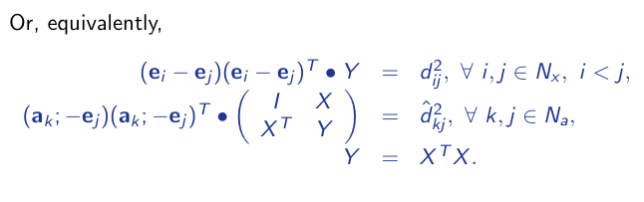
Matrix Represenation II

Slide 46
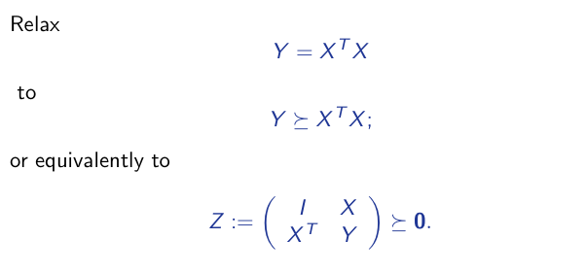
SDP Relaxation [Biswas-Ye 2004]

Slide 47
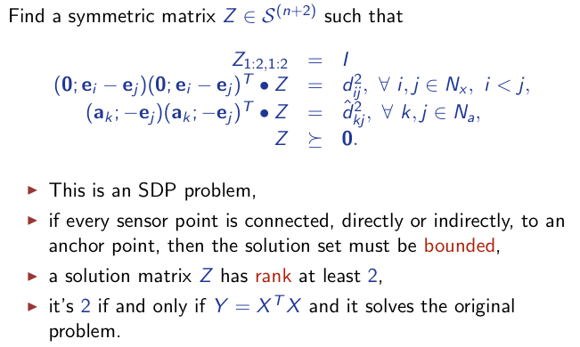
SDP Standard Form [Biswas-Ye 2004]

Slide 48
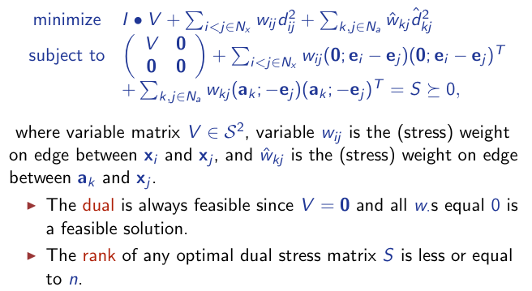
SDP Dual Form [Biswas-Ye 2004]

Slide 49
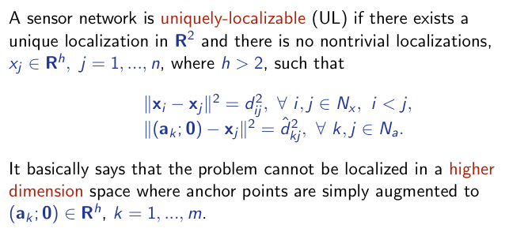
Unique Localizability
UL is called universal rigidity.

Slide 50
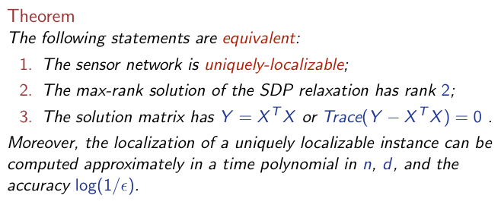
ULP is localizable in polynomial time [So-Ye 2005]

Slide 51
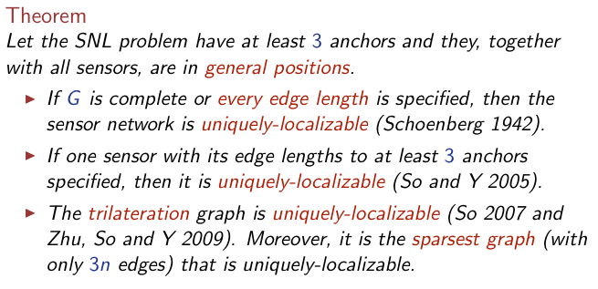
UL Graphs

Slide 52
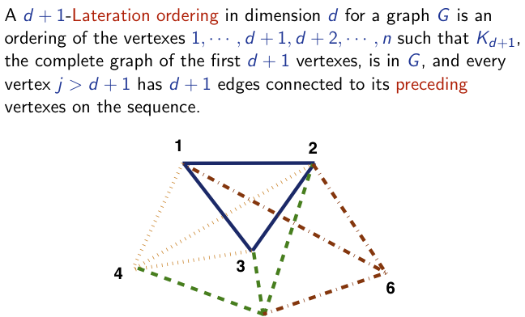
d-lateration Graphs

Slide 53
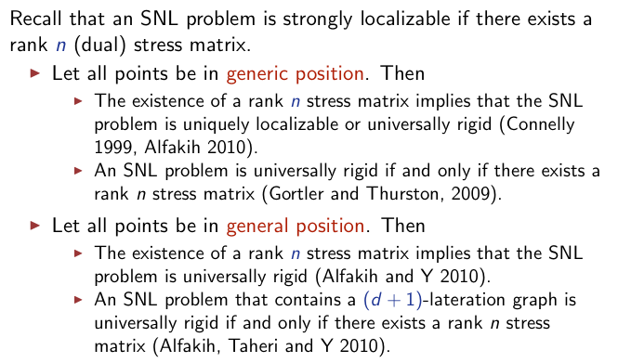
Open Problems in Sensor Network Localization

Slide 54
Reference
Schoenberg, I. J. (1938a) Metric Spaces and Completely Monotone Functions. The Annals of Mathematics 39, 811–841
Schoenberg, I. J. (1938b) Metric Spaces and Positive Definite Functions. Transactions of the American Mathematical Society 44, 522–536
Francois Bavaud (2010) On the Schoenberg Transformations in Data Analysis: Theory and Illustrations, arXiv:1004.0089v2
T. F. Cox and M. A. A. Cox, Multidimensional Scaling. New York: Chapman & Hall, 1994.
Yinyu Ye, Semidefinite Programming and its Low-Rank Theorems, ICCM 2010

Slide 55
Nonlinear Manifolds..
A
PCA and MDS see the Euclidean
distance
What is important is the geodesic distance
Unfold the manifold

Slide 56
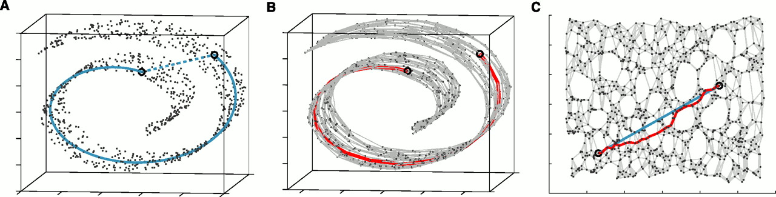
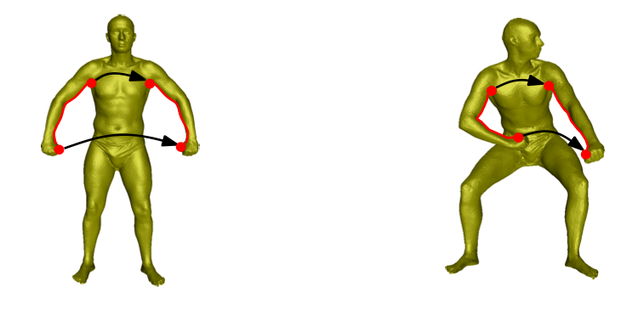
Intrinsic Description..
To preserve structure, preserve the geodesic distance and not the Euclidean distance.

Slide 57
Two Basic Geometric Embedding Methods
Tenenbaum-de Silva-Langford Isomap Algorithm
Global approach.
On a low dimensional embedding
Nearby points should be nearby.
Faraway points should be faraway.
Roweis-Saul Locally Linear Embedding Algorithm
Local approach
Nearby points nearby

Slide 58
Isomap
Estimate the geodesic distance between faraway points.
For neighboring points Euclidean distance is a good approximation to the geodesic distance.
For faraway points estimate the distance by a series of short hops between neighboring points.
Find shortest paths in a graph with edges connecting neighboring data points
Once we have all pairwise geodesic distances use classical metric MDS

Slide 59
Isomap - Algorithm
Determine the neighbors.
All points in a fixed radius.
K nearest neighbors
Construct a neighborhood graph.
Each point is connected to the other if it is a K nearest neighbor.
Edge Length equals the Euclidean distance
Compute the shortest paths between two nodes
Floyd’s Algorithm (O(N³))
Dijkstra’s Algorithm (O(kN²logN))
Construct a lower dimensional embedding.
Classical MDS

Slide 60
Example…

Slide 61
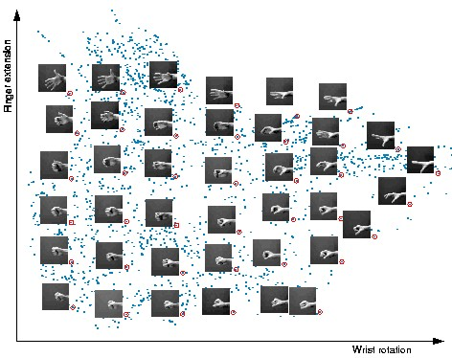

Slide 63
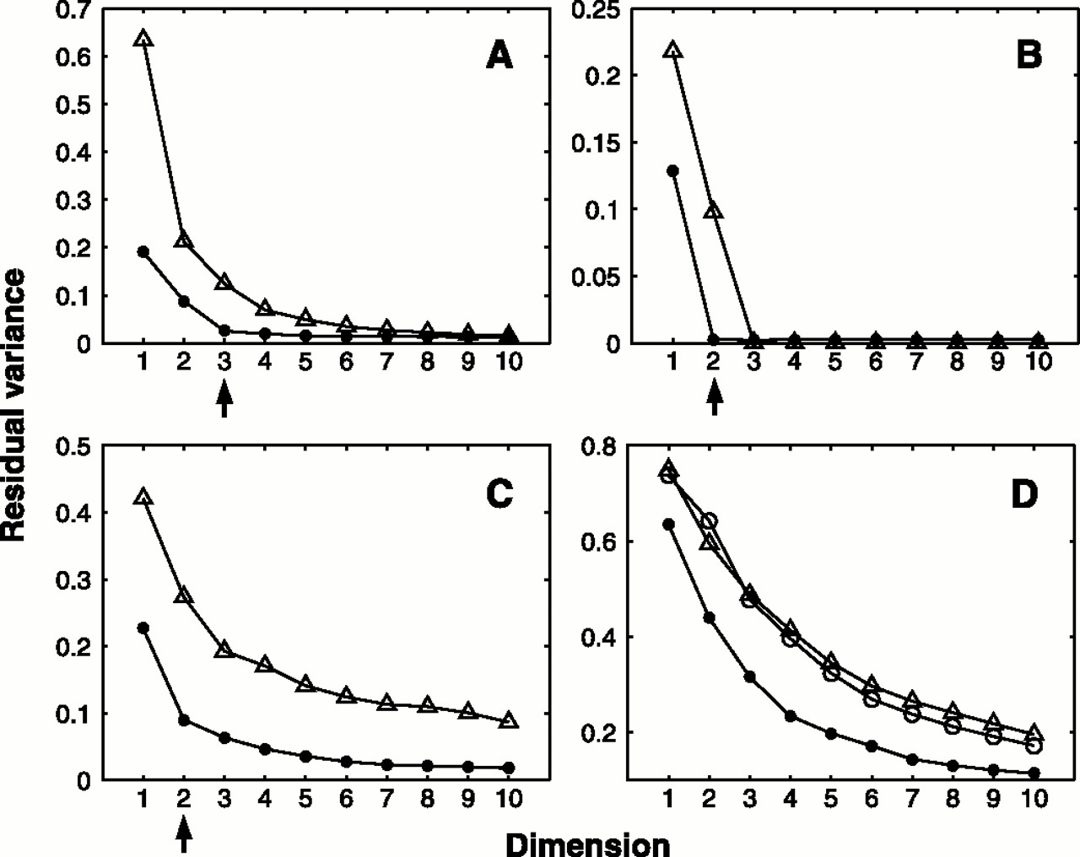
Residual Variance
Face Images
SwisRoll
Hand Images
2

Slide 64
Biomolecular: Alanine-dipeptide
ISOMAP 3D embedding with RMSD metric on 3900 Kcenters

Slide 65
Convergence of ISOMAP
ISOMAP has provable convergence guarantees;
Given that {x_{i}} is sampled sufficiently dense, ISOMAP will approximate closely the original distance as measured in manifold M;
In other words, actual geodesic distance approximations using graph G can be arbitrarily good;
Let’s examine these theoretical guarantees in more detail …

Slide 66
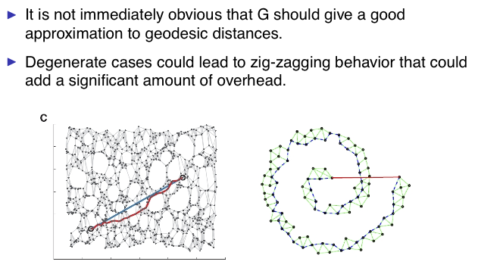
Possible Issues

Slide 67
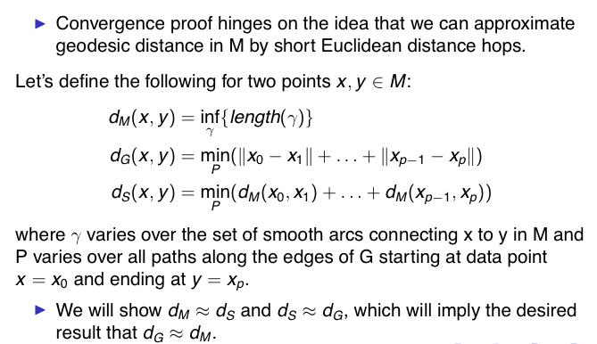
Two step approximations

Slide 68
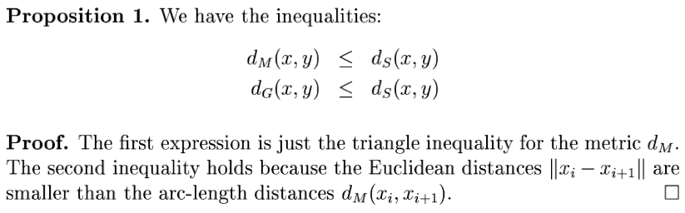

Slide 69
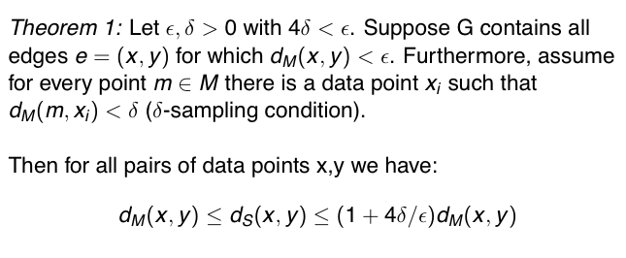
Dense-sampling Theorem [Bernstein, de Silva, Langford, and Tenenbaum 2000]

Slide 70
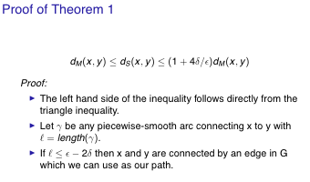
Proof

Slide 71
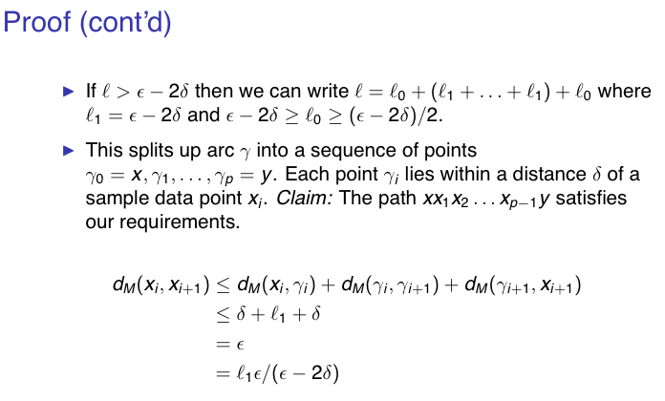
Proof

Slide 72
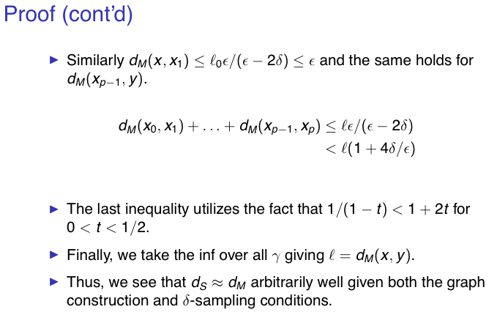
Proof

Slide 73
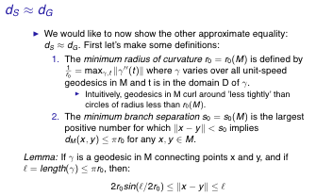
The Second Approximation

Slide 74
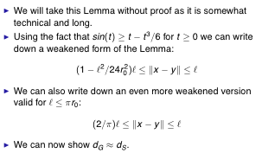
Remarks

Slide 75
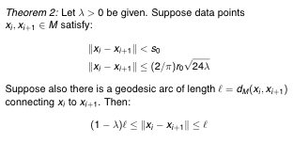
Theorem 2 [Bernstein, de Silva, Langford, and Tenenbaum 2000]

Slide 76
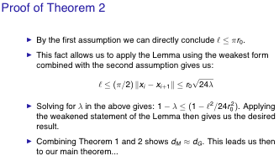
Proof

Slide 77
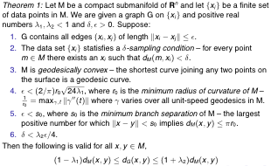
Main Theorem [Bernstein, de Silva, Langford, and Tenenbaum 2000]

Slide 78
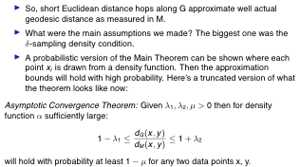
Probabilistic Result

Slide 79
A Shortcoming of ISOMAP
One need to compute pairwise shortest path between all sample pairs (i,j)
Global
Non-sparse
Cubic complexity O(N³)

Slide 80
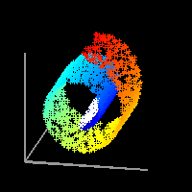
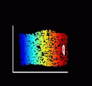
Locally Linear Embedding
manifold is a topological space which is locally Euclidean.”
Fit Locally, Think Globally

Slide 81


Fit Locally…
We expect each data point and its
neighbours to lie on or close
to a locally linear patch of the
manifold.
Each point can be written as a linear combination of its neighbors.
The weights choosen to
minimize the reconstruction
Error.
Derivation on board

Slide 82
Important property...
The weights that minimize the reconstruction errors are invariant to rotation, rescaling and translation of the data points.
Invariance to translation is enforced by adding the constraint that the weights sum to one.
The same weights that reconstruct the datapoints in D dimensions should reconstruct it in the manifold in d dimensions.
The weights characterize the intrinsic geometric properties of each neighborhood.

Slide 83


Think Globally…

Slide 84
Algorithm (K-NN)
Local fitting step (with centering):
Consider a point x_{i}
Choose its K(i) neighbors η_{j} whose origin is at x_{i}
Compute the (sum-to-one) weights w_{ij} which minimizes
Contruct neighborhood inner product:
Compute the weight vector w_{i}=(w_{ij}), where 1 is K-vector of all-one and λ is a regularization parameter
Then normalize w_{i} to a sum-to-one vector.

Slide 85
Algorithm (K-NN)
Local fitting step (without centering):
Consider a point x_{i}
Choose its K(i) neighbors x_{j}
Compute the (sum-to-one) weights w_{ij} which minimizes
Contruct neighborhood inner product:
Compute the weight vector w_{i}=(w_{ij}), where

Slide 86
Algorithm continued
Global embedding step:
Construct N-by-N weight matrix W:
Compute d-by-N matrix Y which minimizes
Compute:
Find d+1 bottom eigenvectors of B, v_{n},v_{n-1},…,v_{n-d}
Let d-dimensional embedding Y =[ v_{n-1},v_{n-2},…v_{n-1}]

Slide 87
Remarks on LLE
Searching k-nearest neighbors is of O(kN)
W is sparse, kN/N^2=k/N nozeros
W might be negative, additional nonnegative constraint can be imposed
B=(I-W)^{T}(I-W) is positive semi-definite (p.s.d.)
Open Problem: exact reconstruction condition?

Slide 88


Slide 89


Slide 90


Slide 91

Grolliers Encyclopedia

Slide 92
Summary..
ISOMAP | LLE
Do MDS on the geodesic distance matrix. | Model local neighborhoods as linear a patches and then embed in a lower dimensional manifold.
Global approach | Local approach
Might not work for nonconvex manifolds with holes | Nonconvex manifolds with holes
Extensions: Landmark, Conformal & Isometric ISOMAP | Extensions: Hessian LLE, Laplacian Eigenmaps etc.
Both needs manifold finely sampled.

Slide 93
Reference
Tenenbaum, de Silva, and Langford, A Global Geometric Framework for Nonlinear Dimensionality Reduction. Science 290:2319-2323, 22 Dec. 2000.
Roweis and Saul, Nonlinear Dimensionality Reduction by Locally Linear Embedding. Science 290:2323-2326, 22 Dec. 2000.
M. Bernstein, V. de Silva, J. Langford, and J. Tenenbaum. Graph Approximations to Geodesics on Embedded Manifolds. Technical Report, Department of Psychology, Stanford University, 2000.
V. de Silva and J.B. Tenenbaum. Global versus local methods in nonlinear dimensionality reduction. Neural Information Processing Systems 15 (NIPS’2002), pp. 705-712, 2003.
V. de Silva and J.B. Tenenbaum. Unsupervised learning of curved manifolds. Nonlinear Estimation and Classification, 2002.
V. de Silva and J.B. Tenenbaum. Sparse multidimensional scaling using landmark points. Available at: http://math.stanford.edu/~silva/public/publications.html

Slide 94
Matlab Dimensionality Reduction Toolbox
http://homepage.tudelft.nl/19j49/Matlab_Toolbox_for_Dimensionality_Reduction.html
Math.pku.edu.cn/teachers/yaoy/Spring2011/matlab/drtoolbox
Principal Component Analysis (PCA), Probabilistic PC
Factor Analysis (FA), Sammon mapping, Linear Discriminant Analysis (LDA)
Multidimensional scaling (MDS), Isomap, Landmark Isomap
Local Linear Embedding (LLE), Laplacian Eigenmaps, Hessian LLE, Conformal Eigenmaps
Local Tangent Space Alignment (LTSA), Maximum Variance Unfolding (extension of LLE)
Landmark MVU (LandmarkMVU), Fast Maximum Variance Unfolding (FastMVU)
Kernel PCA
Diffusion maps
…

